Slide 1
Partial and Semipartial Correlations
Regression Analysis and Non-Linear Models: Sociology 6100

Slide 2
Correlation
Pearson Product Moment Correlation
Used to test relationship between two ratio variables
Does not control for other variables
Ranges -1.0 and +1.0
e.g. Education and income, work commitment and job satisfaction

Slide 3
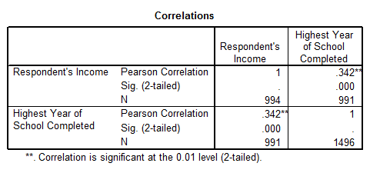
Correlation (continued)

Slide 4
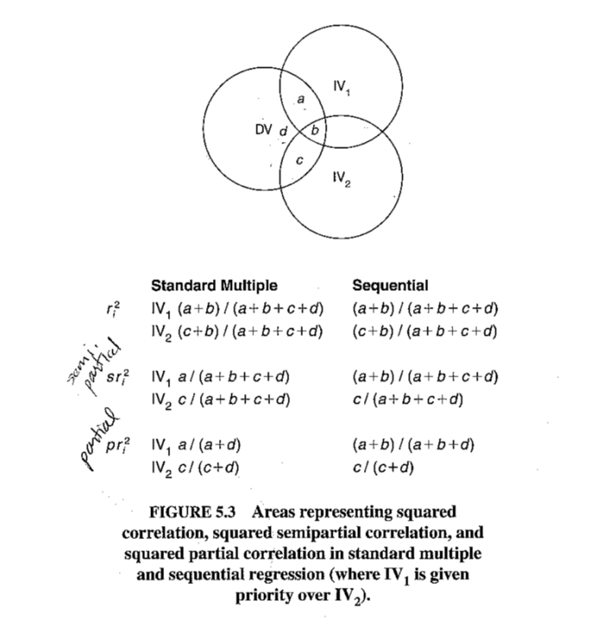
Venn Diagram of Partial Correlation

Slide 5
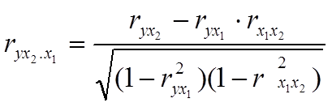

Partial Correlation
Strength of association between Y and X, controlling for other IV’s
$Y=∝+β_{1}X_{1}$ $+β_{2}X_{2}+…+ β_{k}X_{k}$
Correlation between Y and $X_{2}$ , removing the impact of $X_{1}$ from both Y’s and X’s
First-order partial correlation: control for one IV
Pearson correlation: Zero-order correlation

Slide 6
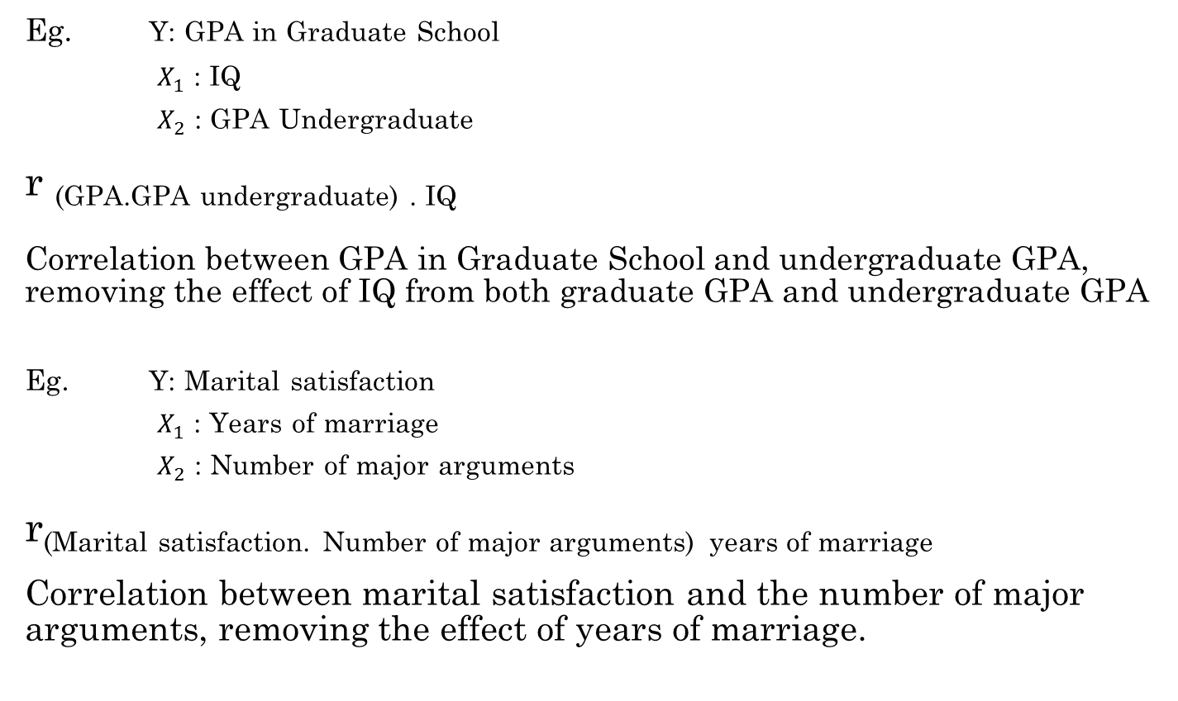
Partial Correlation (cont.)
Eg. Y: GPA in Graduate School
$X_{1}$ : IQ
$X_{2}$ : GPA Undergraduate
r _{(GPA.GPA undergraduate) . IQ}
Correlation between GPA in Graduate School and undergraduate GPA, removing the effect of IQ from both graduate GPA and undergraduate GPA
Eg. Y: Marital satisfaction
$X_{1}$ : Years of marriage
$X_{2}$ : Number of major arguments
r(Marital satisfaction. Number of major arguments) _{years of marriage}
Correlation between marital satisfaction and the number of major arguments, removing the effect of years of marriage.

Slide 7
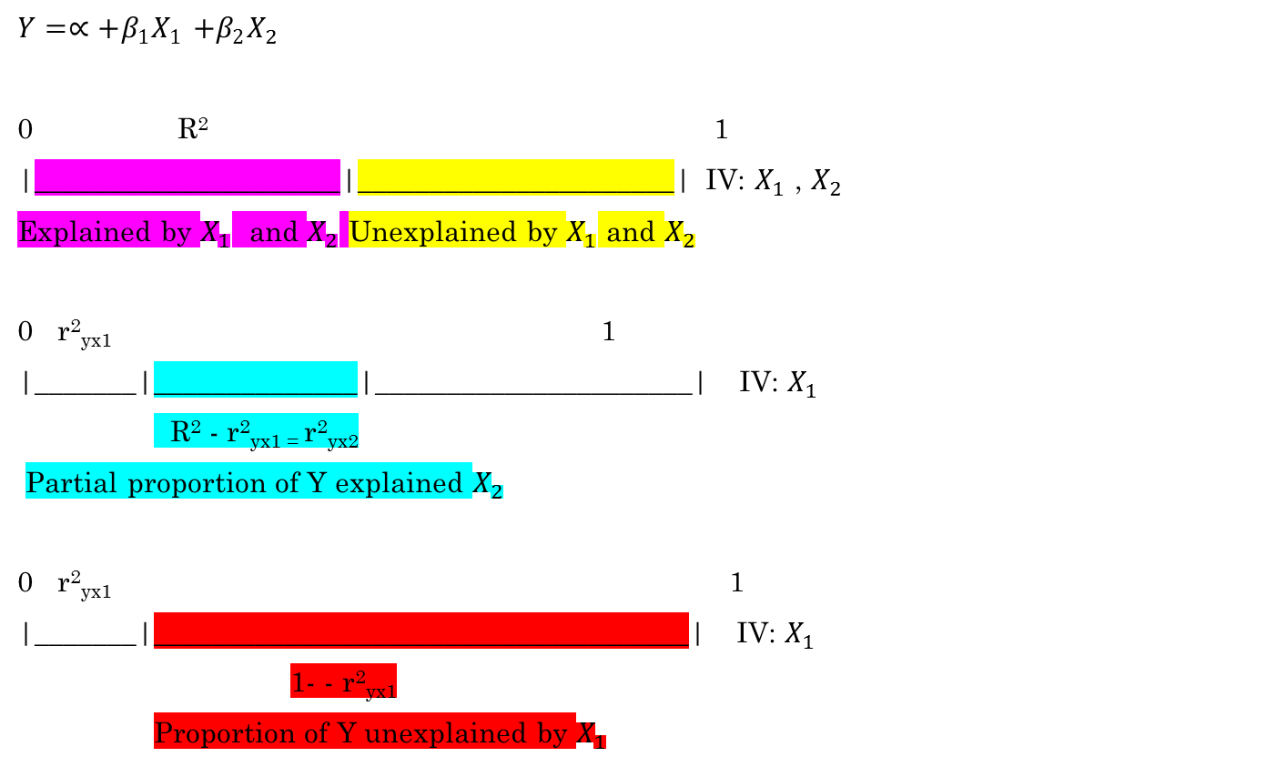
Partial Correlation (cont.)
$Y=∝+β_{1}X_{1}$ $+β_{2}X_{2}$
0 R² 1
|_____________________|______________________| IV: $X_{1}$ , $X_{2}$
Explained by $X_{1}$ and $X_{2}$ Unexplained by $X_{1}$ and $X_{2}$
0 r²_{yx1} 1
|_______|_______­­_______|______________________| IV: $X_{1}$
R² - r²_{yx1 =} r²_{yx2}
Partial proportion of Y explained $X_{2}$
0 r²_{yx1} 1
|_______|_______­­______________________________| IV: $X_{1}$
1- - r²_{yx1}
Proportion of Y unexplained by $X_{1}$

Slide 8
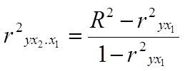

Partial Correlation (cont.)
Proportion of variation of Y explained by $X_{2}$ , removing the effect of $X_{1}$ from Y and $X_{2}$;

Slide 9

Second-Order and Higher-order Partial Correlations
Correlation between Y and X, controlling for other IV’s

Slide 10
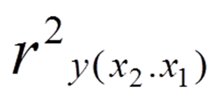

Semipartial Correlation (Part Correlation)
Correlation between Y and $X_{2}$, removing the effect of $X_{1}$ only from $X_{2}$

Slide 11
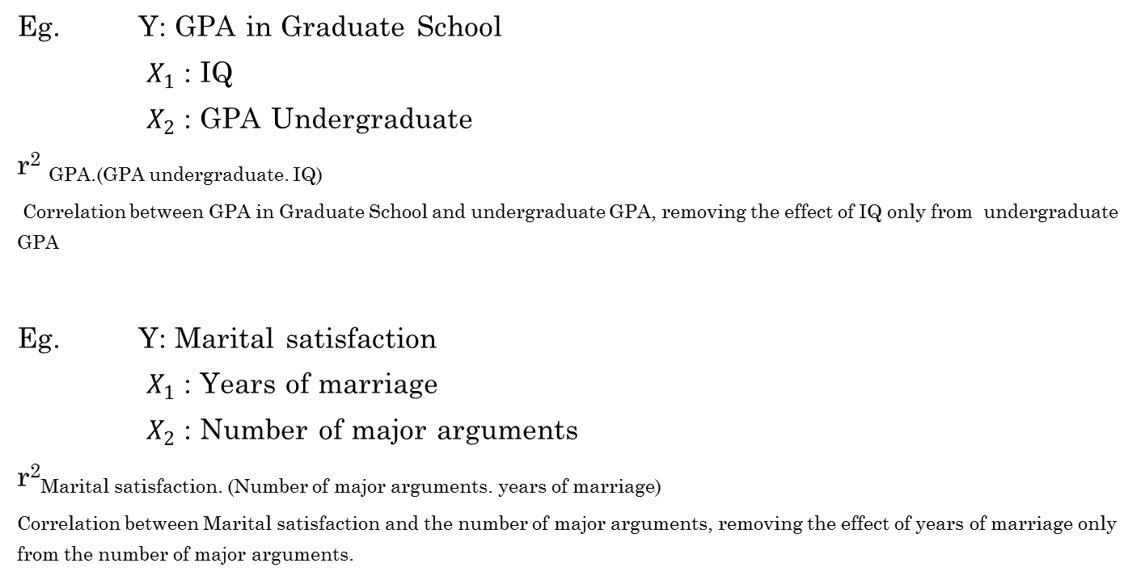
Second-Order and Higher-order Semipartial Correlations (cont.)
Eg. Y: GPA in Graduate School
$X_{1}$: IQ
$X_{2}$: GPA Undergraduate
r² _{GPA.(GPA undergraduate. IQ)}
Correlation between GPA in Graduate School and undergraduate GPA, removing the effect of IQ only from undergraduate GPA
Eg. Y: Marital satisfaction
$X_{1}$: Years of marriage
$X_{2}$: Number of major arguments
r²Marital satisfaction. (Number of major arguments. years of marriage)
Correlation between Marital satisfaction and the number of major arguments, removing the effect of years of marriage only from the number of major arguments.

Slide 12
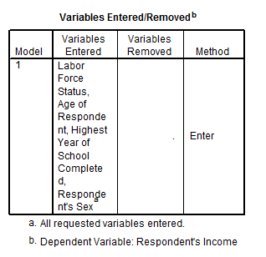
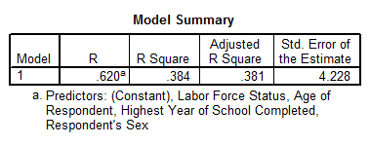
Regression
[DataSet1] C:\Program Files\SPSS\GSS93 subset.sav

Slide 13
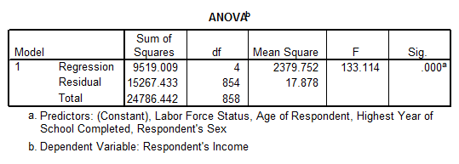
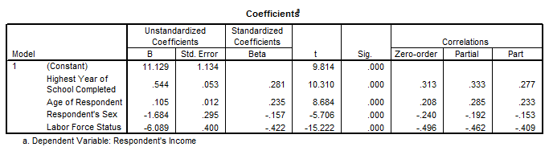
Regression (cont.)
Correlation between $ and Education, removing the effect of Age, Sex, and Labor force status, is 0.333
Correlation between $ and Education, removing the effect of Age, Sex, and Labor force status from Education, is 0.277.

Slide 14
Example
There are strong correlations among x, y, z.
x and z are strongly correlated with each other. Regression analysis also shows z has a strong effect on x.
However, when y is included in a regression analysis, z becomes insignificant, meaning y explains whole variance of x.

Slide 15
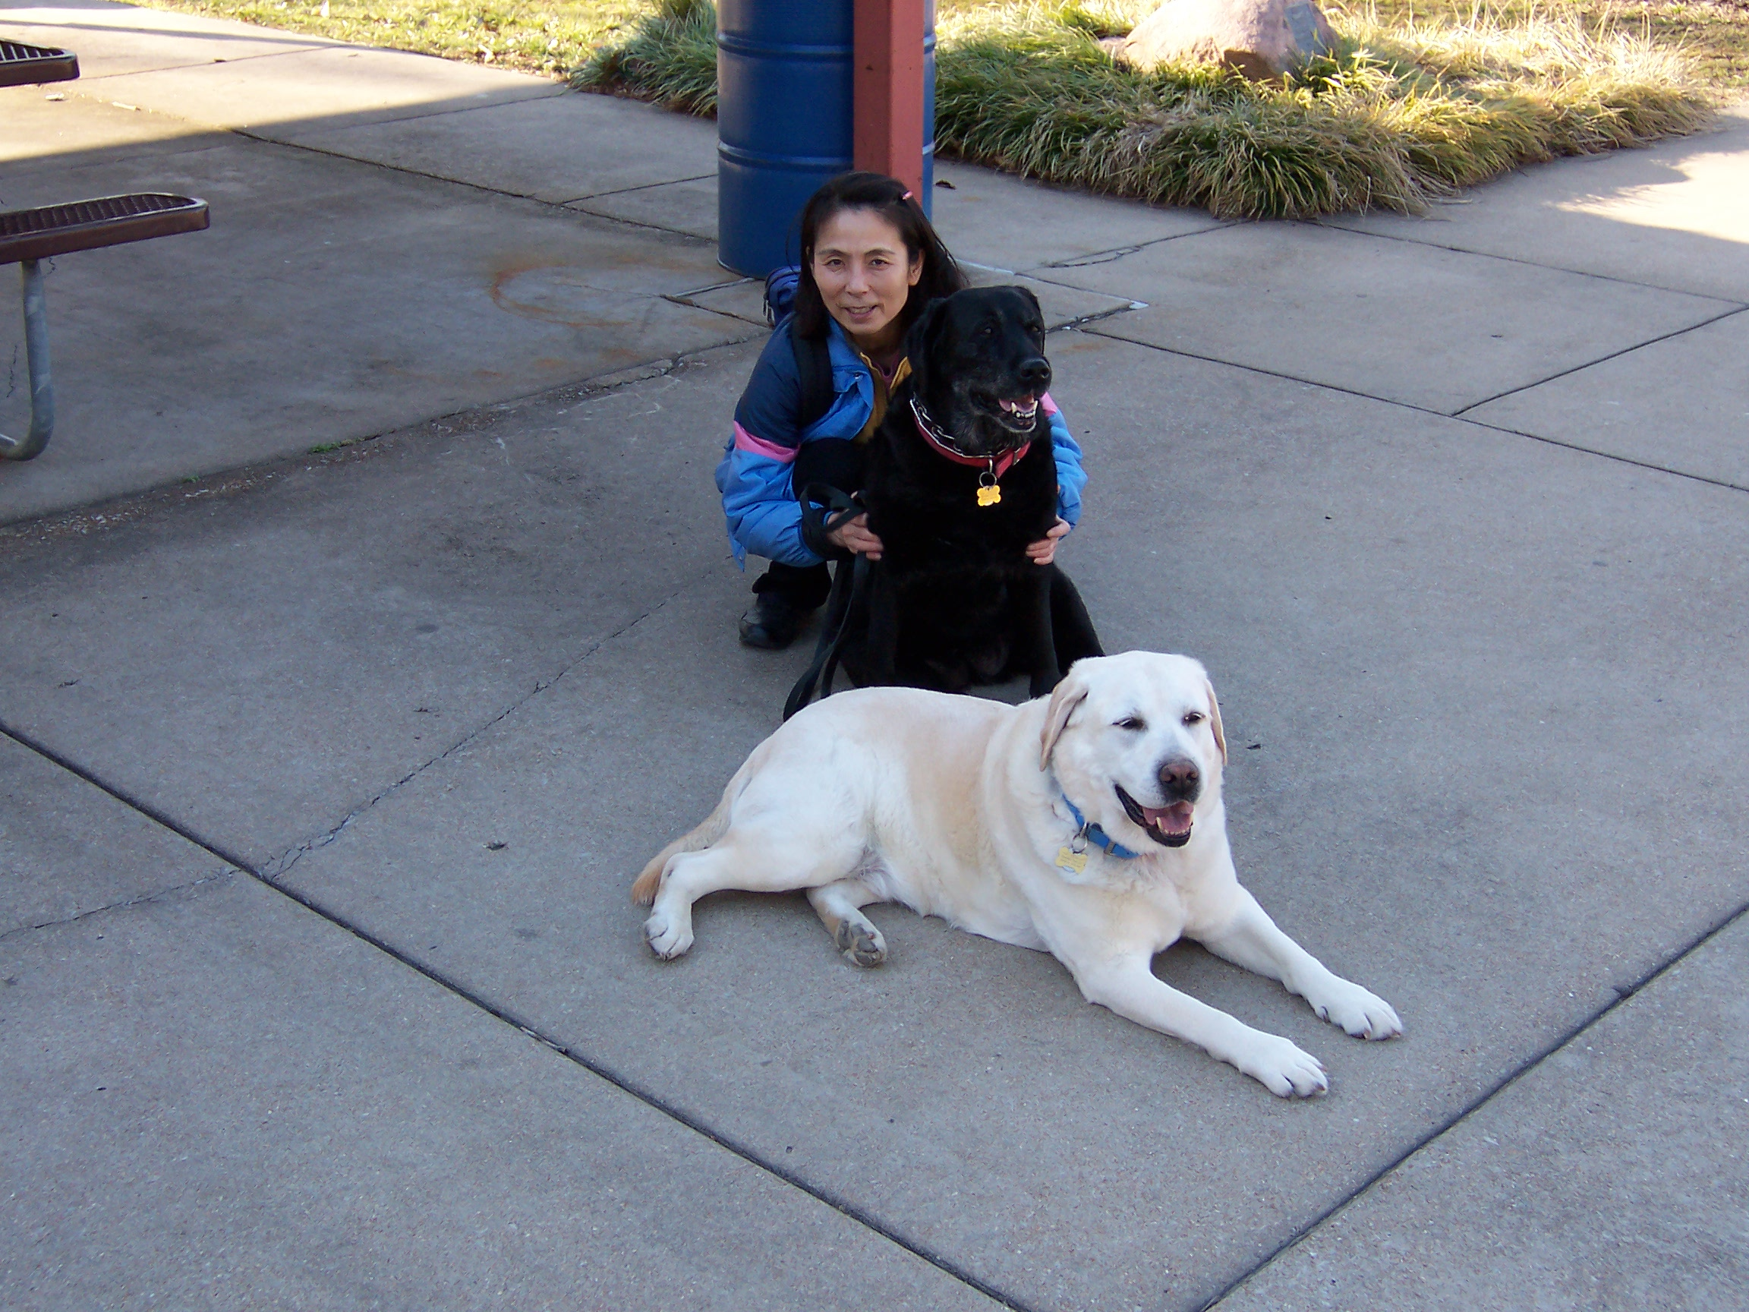
Questions!

